Slide 1

Score-based Models
22-808: Generative models
Sharif University of Technology
Fall 2025
Fatemeh Seyyedsalehi
Slides of this lecture are selected from Yong Song’s and Stanford CS236

Slide 2
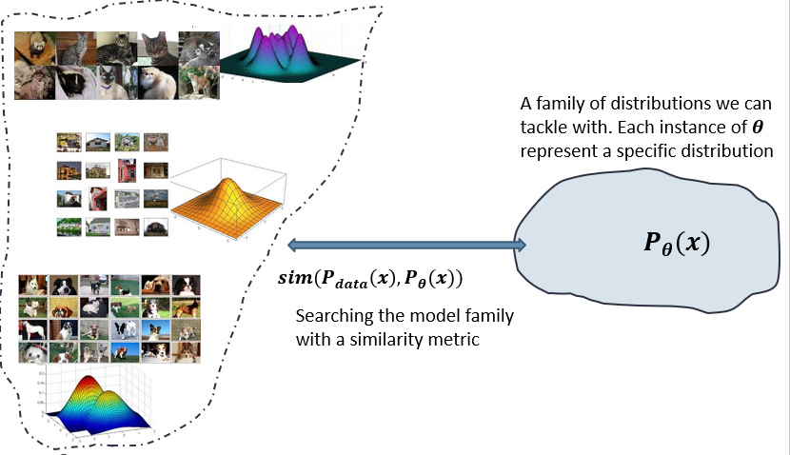
Recap
We need a framework to interact with distributions for statistical generative models.
  Probabilistic generative models
  Deep generative models
    Autoregressive models
    Variational Autoencoders
    Generative adversarial networks
    Normalizing Flow
    Energy-based models
    Score-based models

Slide 3
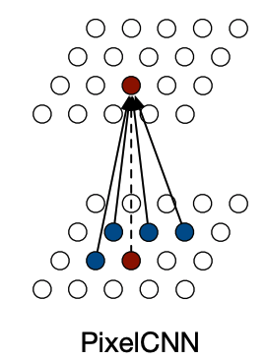
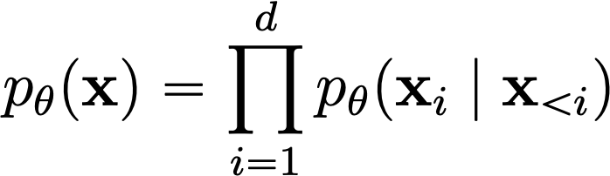
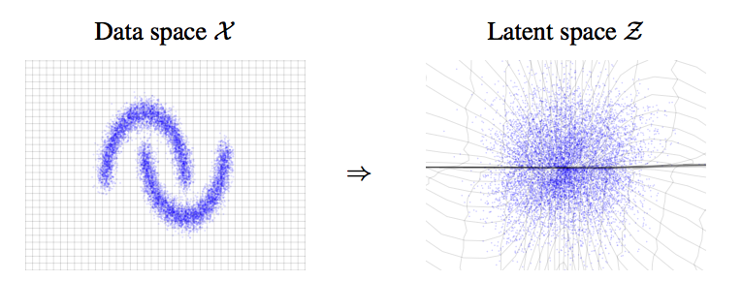
How to represent probability distributions?
Probability density function (p.d.f.) or probability mass function (p.m.f.)
Autoregressive models
Flow models
Notes:
Generative modeling is the task of learning a model of probability distribution from data. However, how can we represent a probability distribution? There are many ways, and generative models can be largely categorized according to this.
One common way of representing the probability distribution is the probability density function.
We have many popular density models that model the probability density function. They can be trained by maximum likelihood.

Slide 4
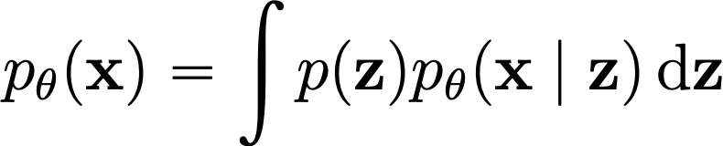
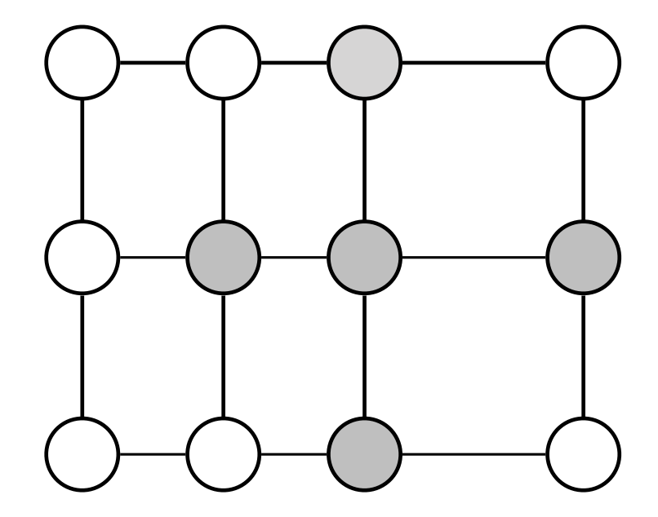
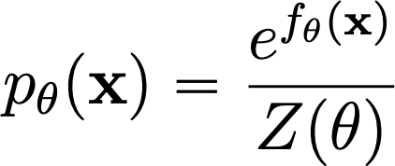
How to represent probability distributions?
Probability density function (p.d.f.) or probability mass function (p.m.f.)
Variational autoencoders
Energy-based models
Notes:
Generative modeling is the task of learning a model of probability distribution from data. However, how can we represent a probability distribution? There are many ways, and generative models can be largely categorized according to this.
One common way of representing the probability distribution is the probability density function.
We have many popular density models that model the probability density function. They can be trained by maximum likelihood.

Slide 5
How to represent probability distributions?
Probability density function (p.d.f.) or probability mass function (p.m.f.)
Pros
    Maximum likelihood training
    Principled model comparison via likelihoods
Cons
    Special architectures or surrogate losses to deal with intractable partition functions
Notes:
Generative modeling is the task of learning a model of probability distribution from data. However, how can we represent a probability distribution? There are many ways, and generative models can be largely categorized according to this.
One common way of representing the probability distribution is the probability density function.
We have many popular density models that model the probability density function. They can be trained by maximum likelihood.

Slide 6
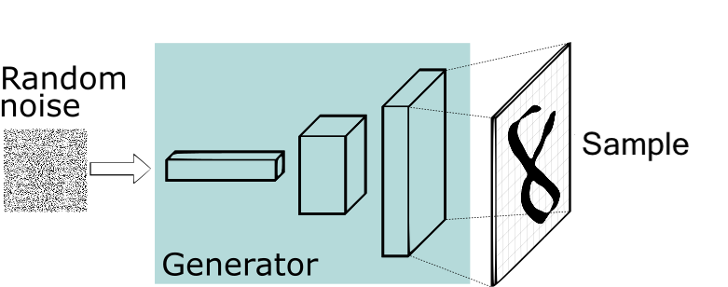


How to represent probability distributions?
Sampling process
Generative adversarial networks (GANs)
GAN
Notes:
In addition to the probability density function, we can also use iid sampling process to represent a probability distribution.
In general, many sample generation processes can be viewed as first drawing \epsilon from a simple and well-known prior distribution p(\epsilon), and then mapping \epsilon through a deterministic transformation g_\theta to get a sample x. In order to model a sample generation process, we can simply model the deterministic transformation g_\theta.
The typical example of such a model is the generative adversarial networks. GANs can be learnt from data using adversarial training approaches.

Slide 7
How to represent probability distributions?
Sampling process
Pros
    Samples typically have better quality
Cons
    Require adversarial training. Training instability and mode collapse.
    No principled way to compare different models
    No principled termination criteria for training
Notes:
In addition to the probability density function, we can also use iid sampling process to represent a probability distribution.
In general, many sample generation processes can be viewed as first drawing \epsilon from a simple and well-known prior distribution p(\epsilon), and then mapping \epsilon through a deterministic transformation g_\theta to get a sample x. In order to model a sample generation process, we can simply model the deterministic transformation g_\theta.
The typical example of such a model is the generative adversarial networks. GANs can be learnt from data using adversarial training approaches.

Slide 8
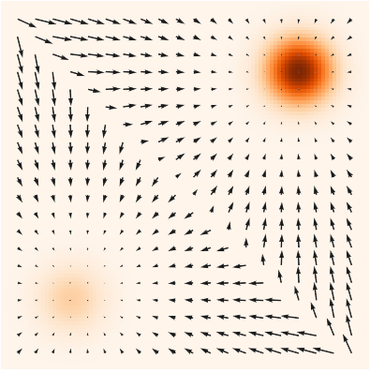
How to represent probability distributions?
When the pdf is differentiable, we can compute the gradient of a probability density.
Score function
(pdf and score)
(Electrical potentials and fields)
Notes:
In this talk, I am going to focus on another way of representing a probability distribution. Notice that when the pdf function is differentiable, we can compute the gradient of a probability density wrt the random variable. This gradient is widely known as the score function of a probability distribution.
In the following image, we show scores and probability density function together for a mixture of Gaussian. The pdf function is color coded, and darker colors indicate higher probability densities. The score is a vector field of gradients that point to directions where probability densities grow most quickly.
The relationship between score and probability density is analogous to the relationship between electric field and electric potential. We know that electric fields and electric potentials are just equivalent ways of describing the same physical phenonmenon. Intuitively, scores and probability densities are also equivalent ways of describing the same continuous probability distribution.
Also in the later part of the talk, we will also see how scores are related to the previous two representations of the probability distributions.

Slide 9


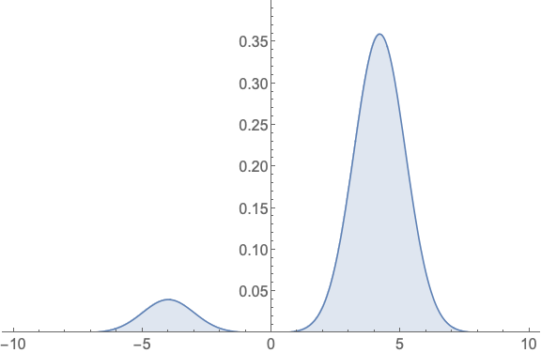
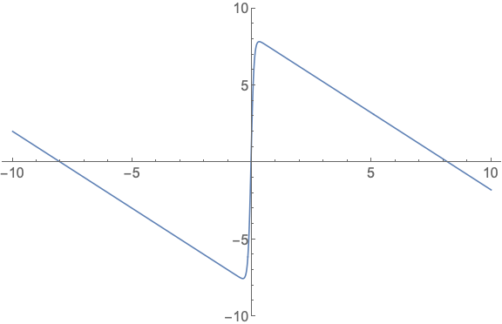

How to represent probability distributions?
When the pdf is differentiable, we can compute the gradient of a probability density.
Score function
Notes:
In this talk, I am going to focus on another way of representing a probability distribution. Notice that when the pdf function is differentiable, we can compute the gradient of a probability density wrt the random variable. This gradient is widely known as the score function of a probability distribution.
In the following image, we show scores and probability density function together for a mixture of Gaussian. The pdf function is color coded, and darker colors indicate higher probability densities. The score is a vector field of gradients that point to directions where probability densities grow most quickly.
The relationship between score and probability density is analogous to the relationship between electric field and electric potential. We know that electric fields and electric potentials are just equivalent ways of describing the same physical phenonmenon. Intuitively, scores and probability densities are also equivalent ways of describing the same continuous probability distribution.
Also in the later part of the talk, we will also see how scores are related to the previous two representations of the probability distributions.

Slide 10
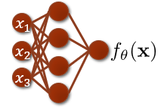
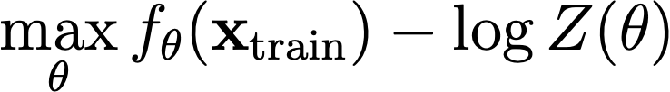

Recap on energy-based models
Deep Energy-Based models (EBMs)
Maximum likelihood training:
    Contrastive divergence
    Requires iterative sampling during training
Notes:
So why should we care about the score function instead of the probability density function? Let's consider learning a deep energy-based model.
A deep energy-based model is a model of probability density functions. It is defined by an arbitrary real-valued function f_\theta.
In order to define a probability distribution, we take the exponential of negative f_\theta to make it positive, and normalize it with a normalizing constant Z_\theta, which is commonly known as the partition function.
However, it’s usually hard to compute the partition function. Therefore, it’s usually treated as an unknown quantity. This is a very flexible model, but learning is tricky.
The typical way is maximizing the expected likelihood on the data distribution. Evaluating the expectation is easy because we can easily estimate it with samples. However, the likelihood involves the log partition function.

Slide 11
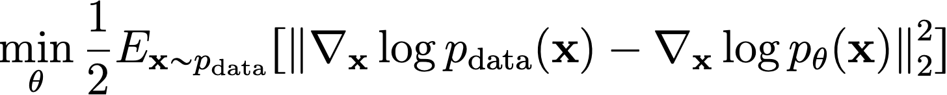
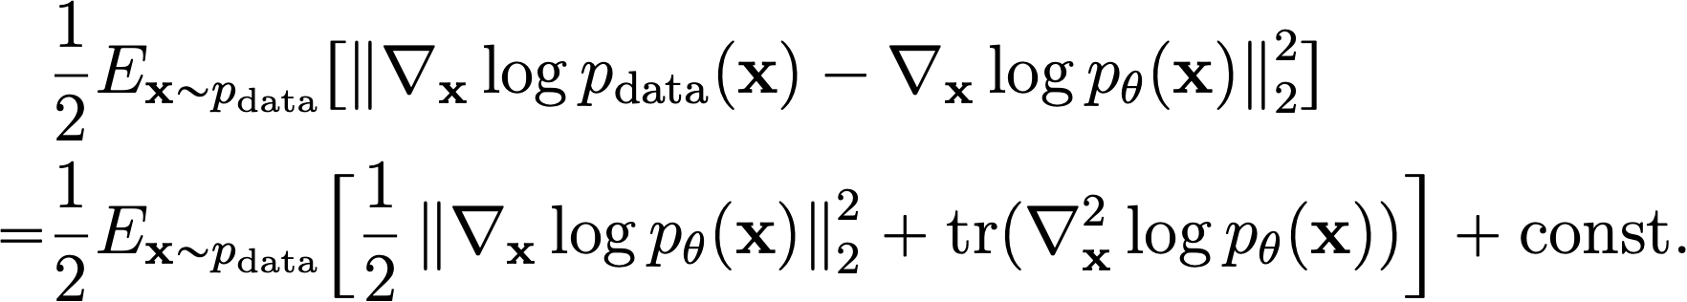
Recap on energy-based models
Deep Energy-Based models (EBMs)
Minimizing Fisher divergence:
    Score matching
Notes:
So why should we care about the score function instead of the probability density function? Let's consider learning a deep energy-based model.
A deep energy-based model is a model of probability density functions. It is defined by an arbitrary real-valued function f_\theta.
In order to define a probability distribution, we take the exponential of negative f_\theta to make it positive, and normalize it with a normalizing constant Z_\theta, which is commonly known as the partition function.
However, it’s usually hard to compute the partition function. Therefore, it’s usually treated as an unknown quantity. This is a very flexible model, but learning is tricky.
The typical way is maximizing the expected likelihood on the data distribution. Evaluating the expectation is easy because we can easily estimate it with samples. However, the likelihood involves the log partition function.

Slide 12
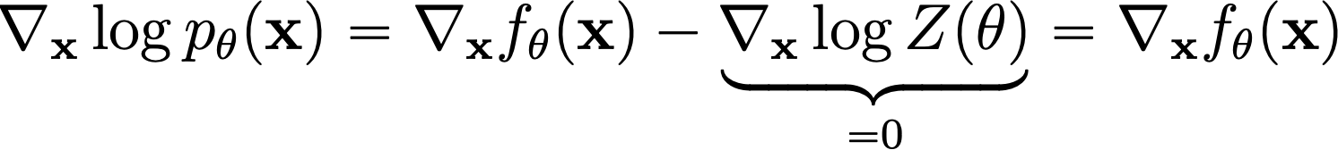
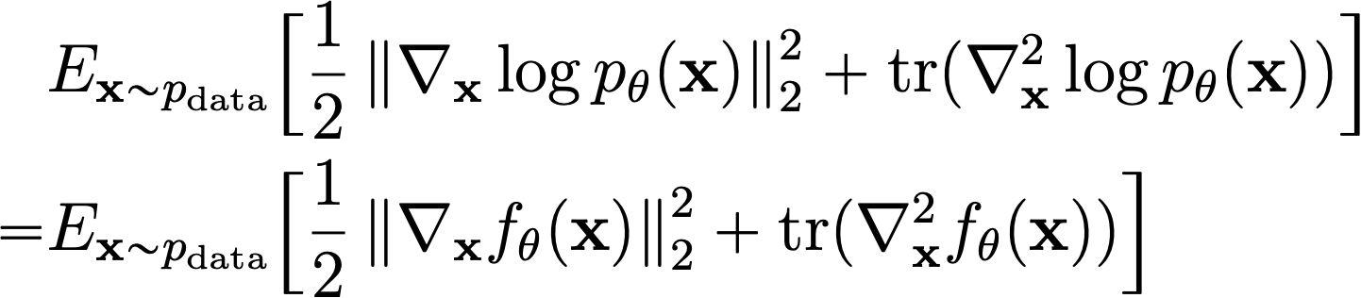
Score matching for training EBMs
Score function of EBMs
Score matching for EBMs:
Is score matching limited to EBMs?
    Autoregressive models
    Normalizing flow models
Notes:
So how can we bypass the intractble partition function? Let's consider the score. It only depends on the gradient of log partition function, which is zero....
Suppose we have the vector field of data scores and model scores. it's clear to see that .....
Suppose we know the data score, we can learn the parameters by ... which does not involve the intractable partition function. This is when score estimation becomes very useful.
Learning generative models is only one application of scores. As a preview...

Slide 13


Score-based models
What’s the most general model that can be efficiently trained by score matching?
Score-based model
?
EBMs
Auto-
regressive
MAFs
flow
Directly model the vector field of gradients!

Slide 14




Score estimation by training score-based models
Probability density
i.i.d. samples
Score function
Notes:
Let's have a formal framework for score estimation.
Intuitively, we have a hidden probability distribution. And the only way to access this distribution is through its iid samples. Now, our task is to estimate the score function using only iid samples. We call this task score estimation.

Slide 15


Score estimation by training score-based models
Given: i.i.d. samples
Task: Estimating the score
Score Model: A learnable vector-valued function
Goal:
How to compare two vector fields of scores?
Average
Euclidean distance
over the space
Notes:
Formally, ...
We propose a score model.
In order to learn the score model, we need some objective to measure the difference between ...
Suppose we have the vector field of scores of p..

Slide 16
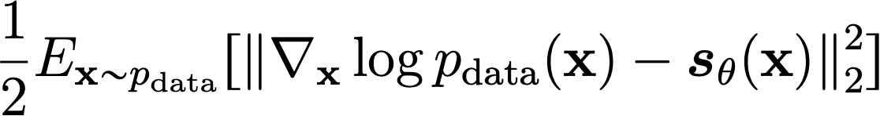
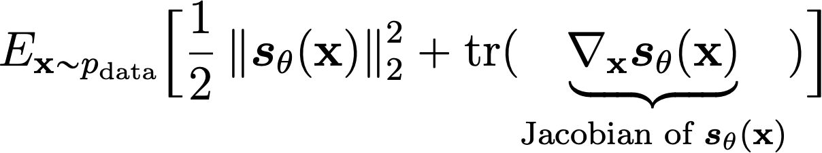
Score estimation by training score-based models
Objective: Average Euclidean distance over the whole space.
Score matching:
Requirements:
    The score model must be efficient to evaluate.
    Do we need the score model to be a proper score function (i.e., gradient of a scalar “energy” function)?
(Fisher divergence)
Notes:
Mathematically, the objective can be written as ...
Unfortunately, we can only sample from p(x), and we don't know the score of p in the Fisher divergence objective.
Luckily, we can use integration by parts...
To gain some intuition, we first consider 1-D fisher divergence.
Analogously, we can obtain the following equivalent form to N-D Fisher divergence using integration by parts.
The expectation can be approximated using iid samples. Draw, empirical average.

Slide 17













Score matching is not scalable
Deep neural networks as more expressive score models
Compute and
$$x_{1}$$
$$s_{θ,1}$$
$$x_{2}$$
$$s_{θ,2}$$
Score Matching
is not Scalable!
$$x_{3}$$
$$s_{θ,3}$$
$${ x}_{1}$$
$$s_{θ,1}$$
Backprops!
$$x_{2}$$
$$s_{θ,2}$$
$$x_{3}$$
$$s_{θ,3}$$
Notes:
In practice, we can increase the expressive power of our score model by parameterizing it as a deep neural network.
In order to use score matching to estiamte our score model,...
Score matching is not very scalable for high dimensional datasets.

Slide 18
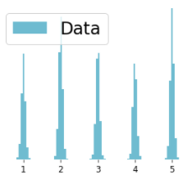
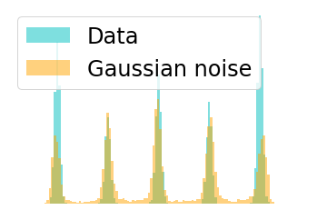
Denoising Score Matching (Vincent, 2011)
Consider the perturbed distribution
Score estimation for is easier
If the noise level is small, this is a good approximation
Notes:
How can we scale up score matching to learn deep score models on high dimensional datasets? The key is to eliminate the trace of Jacobian term in the training objective.
One existing method to do this is called denoising score matching. Instead of estimating the score of p, denoising score matching estimates the score of a perturbed version of p.
Specifically, denoising score matching considers a perturbation kernel q(. | .), which is usually just a Gaussian distribution with mean..
We denote q_sigma as the marginal
When sigma is small,
Denoising score matching shows that if we replace the score p with the score of q_sigma in the Fisher divergence objective, then it has an equivalent form which is scalable to compute.
To see this,...
Can mention Stein unbiased estimator
Therefore, dsm is scalable to ....
However, denoising score matching suffers from inaccurate score estimation because of the perturbation.

Slide 19
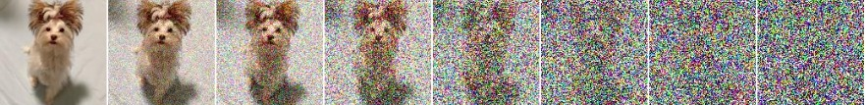
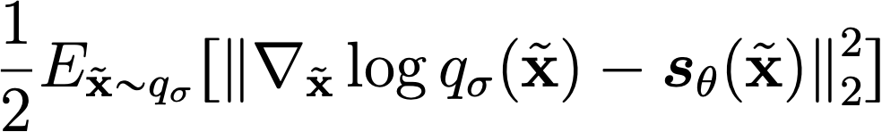


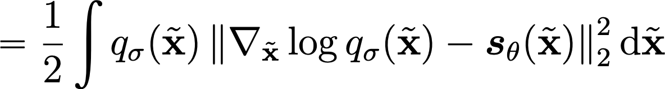
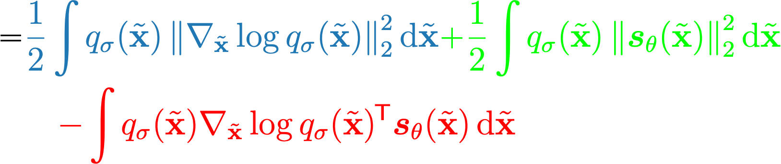


Denoising score matching
Denoising score matching (Vincent 2011): matching the score of a noise-perturbed distribution

Slide 20
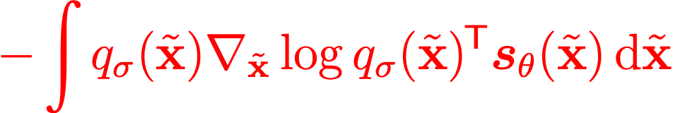
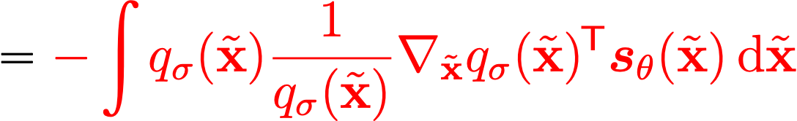
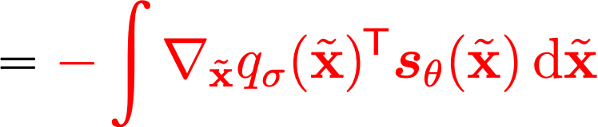
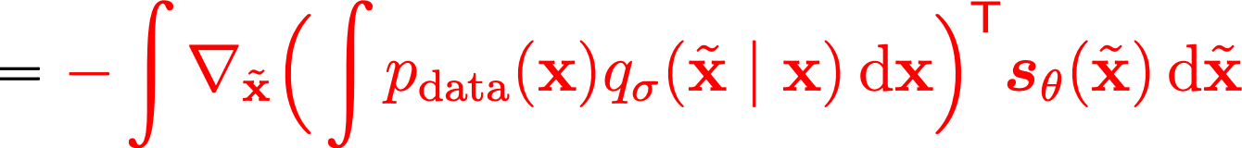
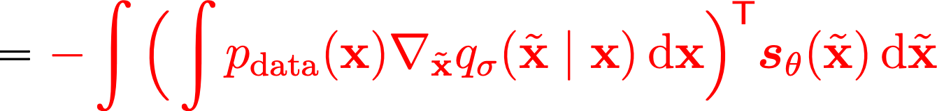
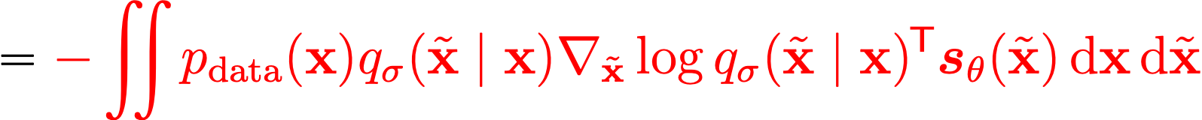
Denoising score matching

Slide 21
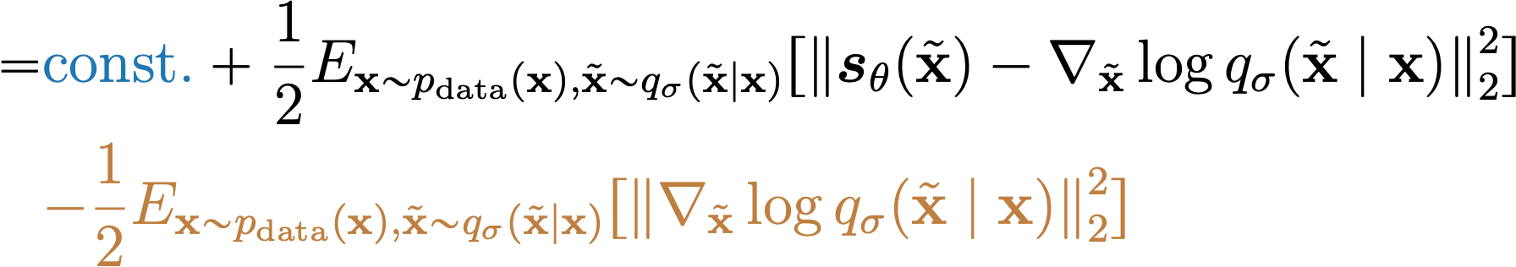
Denoising score matching

Slide 22
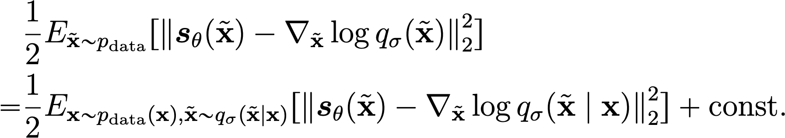


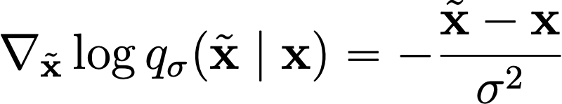
Denoising score matching
Estimate the score of a noise-perturbed distribution
is easy to compute
Pros: efficient to optimize even for very high dimensional data, and useful for optimal denoising.
Con: cannot estimate the score of clean data (noise-free)
Notes:
How can we scale up score matching to learn deep score models on high dimensional datasets? The key is to eliminate the trace of Jacobian term in the training objective.
One existing method to do this is called denoising score matching. Instead of estimating the score of p, denoising score matching estimates the score of a perturbed version of p.
Specifically, denoising score matching considers a perturbation kernel q(. | .), which is usually just a Gaussian distribution with mean..
We denote q_sigma as the marginal
When sigma is small,
Denoising score matching shows that if we replace the score p with the score of q_sigma in the Fisher divergence objective, then it has an equivalent form which is scalable to compute.
To see this,...
Therefore, dsm is scalable to ....
However, denoising score matching suffers from inaccurate score estimation because of the perturbation.

Slide 23


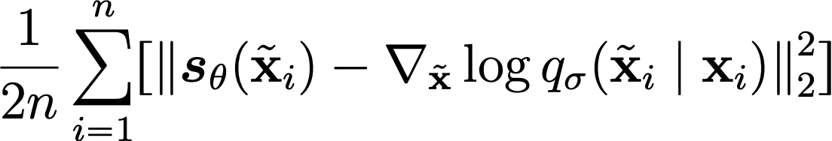
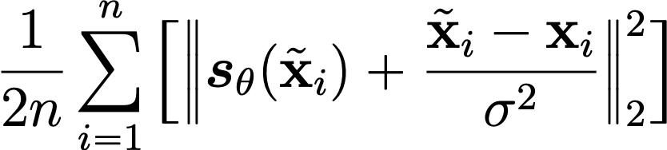
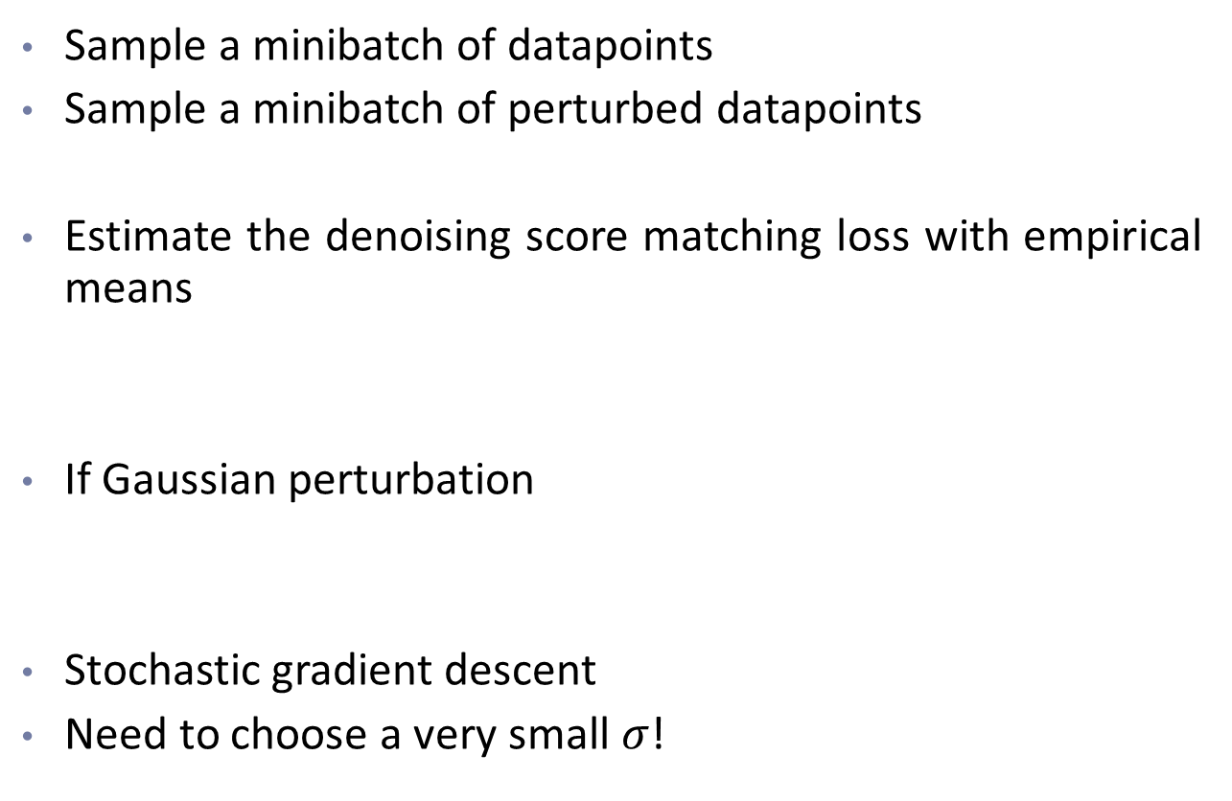
Denoising score matching
Sample a minibatch of datapoints
Sample a minibatch of perturbed datapoints
Estimate the denoising score matching loss with empirical means
If Gaussian perturbation
Stochastic gradient descent
Need to choose a very small $σ$!

Slide 24

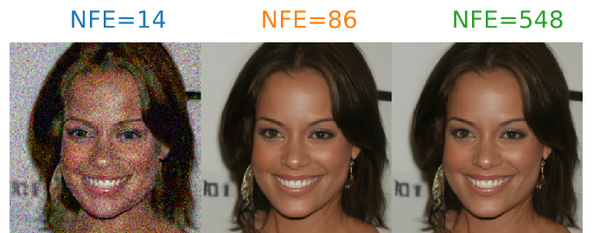

Denoising Score Matching (Vincent, 2011)
Consider the perturbed distribution
Score estimation for is easier
Score matching
Denoising
tries to estimate the noise that was added to produce
x
= x + noise
Notes:
How can we scale up score matching to learn deep score models on high dimensional datasets? The key is to eliminate the trace of Jacobian term in the training objective.
One existing method to do this is called denoising score matching. Instead of estimating the score of p, denoising score matching estimates the score of a perturbed version of p.
Specifically, denoising score matching considers a perturbation kernel q(. | .), which is usually just a Gaussian distribution with mean..
We denote q_sigma as the marginal
When sigma is small,
Denoising score matching shows that if we replace the score p with the score of q_sigma in the Fisher divergence objective, then it has an equivalent form which is scalable to compute.
To see this,...
Can mention Stein unbiased estimator
Therefore, dsm is scalable to ....
However, denoising score matching suffers from inaccurate score estimation because of the perturbation.

Slide 25



Sliced score matching
One dimensional problems should be easier.
Consider projections onto random directions.
$$≈$$
$$≈$$
$$≈$$
Song*, Garg*, Shi, Ermon. "Sliced Score Matching: A Scalable Approach to Density and Score Estimation." UAI 2019.
Notes:
How can we avoid the problem of inaccurate score estimation while still being scalable? In our work, we propose sliced score matching. The motivating idea is that one dimensional problems should be much easier to solve for score matching.
We propose to project score vectors onto random directions, so that the vector field of scores becomes a scalar field. We then compare the projected scalar fields of data and model distributions.
For example, we have vector fields of scores for the data distribution and model distribution. We have picked two random directions. Then, we project all vectors onto those two directions.
It's clear to see that two vector fields are the same if and only if their projections onto all random directions are the same.

Slide 26
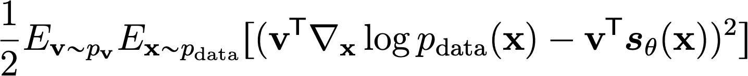
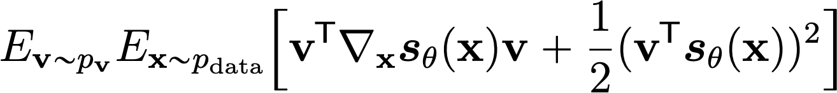
Sliced score matching
Objective: Sliced Fisher Divergence
Integration by parts
?
fast
Sliced Score Matching
Notes:
Mathematically, we summarize the intuition as a new objective named sliced Fisher divergence. Let's use v to denote random directions, and p_v to denote its distribution. The objective can be written as the expected squared difference between the projected scores of the data and model distributions.
We name this objective sliced Fisher divergence. Again, we don't know the data scores, so sliced Fisher divergence cannot be computed directly.
Fortunately, we can play the same trick of integration by parts, as done in score matching.
The objective is the sliced score matching objective. The second term involves the gradient of log p_\theta, which we already know that it can be computed by 1 backpropagation.
The first term still involves Jacobian, but it's in the form of Jacobian-vector products. So is the computation of this term scalable to high dimensions?

Slide 27






Computing Jacobian-vector products is scalable
One Backprop!
$${ x}_{1}$$
$$s_{θ,1}$$
Sliced Score Matching
is scalable
$${ x}_{2}$$
$$s_{θ,2}$$
$$x_{3}$$
$$s_{θ,3}$$
Slightly slower than denoising score matching
Notes:
The answer is yes. To see this, we first rewrite the first term of sliced score matching by explicitly writing the Hessian operator as composition of two gradient operators and moving one vector v inside.
Now we show that the computation can be done with two backpropagations.
As before, we first use one forward propagation to compute f_\theta.
Then we use one backward propagation to compute the gradient of f_\theta.
Next, we compute the inner product of v and the gradient of f_\theta, which is equivalent to adding one additional neuron to the computation graph.
Next, we backpropagate through the whole procedure to get the gradient of the inner product.
Finally, we compute the last inner product.
The whole procedure requires a number of backprop that does not depend on D.

Slide 28

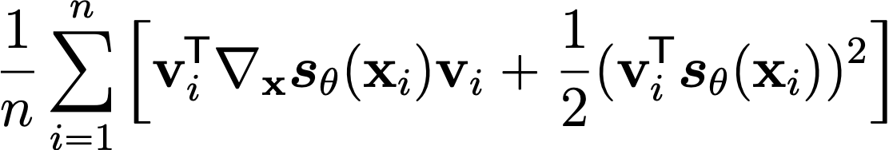
Sliced score matching
Sample a minibatch of datapoints
Sample a minibatch of projection directions
Estimate the sliced score matching loss with empirical means
The projection distribution is typically Gaussian or Rademacher
Stochastic gradient descent
Can use more projections per datapoint to boost performance

Slide 29






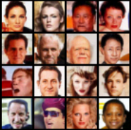




Score-based generative modeling
Score
Matching
?
Data samples
Scores
New samples
Notes:
So far, I have discussed how to estimate scores efficiently from iid samples of a distribution. We can have a score model, and then train it with some efficient variant of score matching to approximate the score of p.
Next, I will show how to build a generative model using the estimated score. This requires us to sample from the score model efficiently.

Slide 30
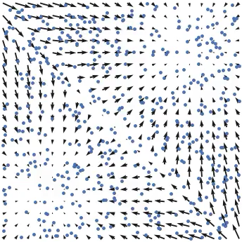
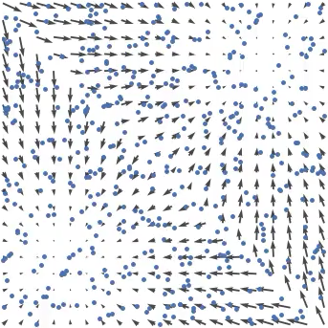

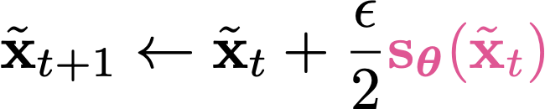

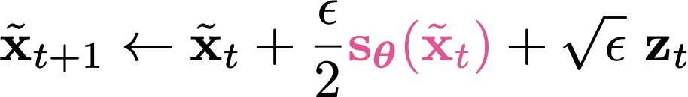
From scores to samples: Langevin MCMC
Scores
Follow the scores
Follow noisy scores:
Langevin MCMC
Notes:
How can we generate samples from scores? One method is Langevin MCMC.
Imagine that we have many random initial data points in the space, and we hope to move these random data points close to samples from the distribution? One intuitive approach might be following the vector field of scores to move our random points. However, this will cause all points to collapse to several local attractors.
Instead, there is a procedure called Langevin dynamics where we follow the scores but add a bit Gaussian noise. This is guaranteed to give correct samples under some conditions.

Slide 31


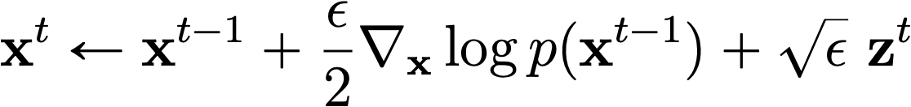


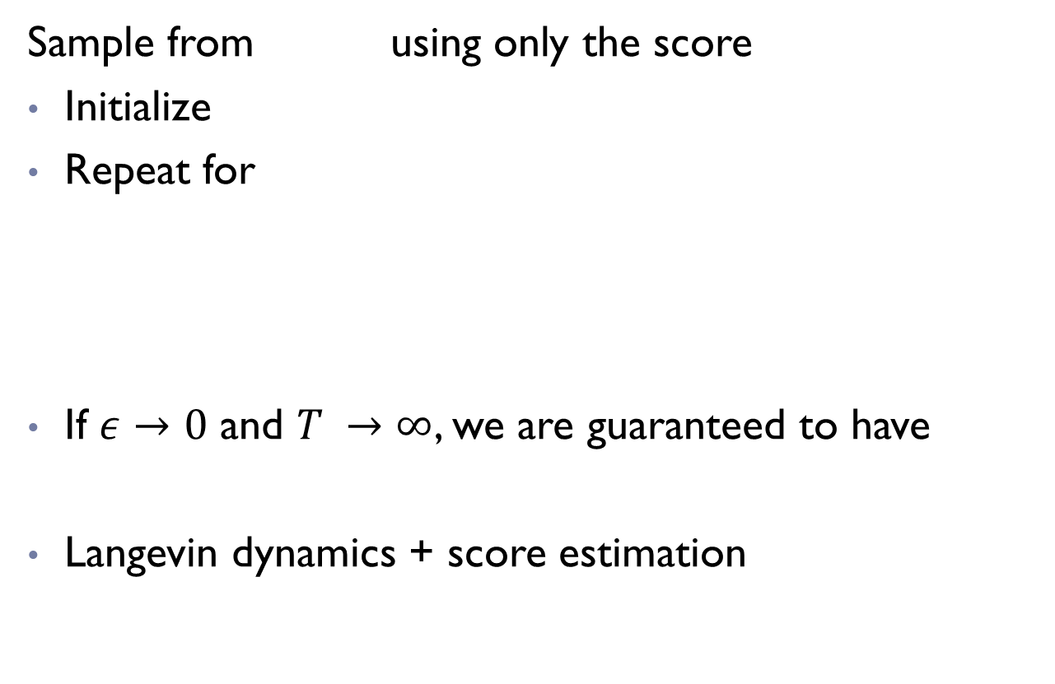
Langevin dynamics sampling
Sample from using only the score
Initialize
Repeat for
If $ε→0$ and $T →∞$, we are guaranteed to have
Langevin dynamics + score estimation
Notes:
Formally, Langevin dynamics is a method to sample from some distribution using only the score. It works by first sampling a initial sample from a simple prior distribution \pi(x). Then, it repeats the following recursive procedure. It first draws a Gaussian noise z, and then add an appropriate scaled version of this noise to the score vector, which is depicted in green.
When epsilon is infinitesimal, Langevin dynamics will produce exact samples in sufficiently long time. In practice, a finite value of epsilon only gives approximate samples, but many authors found the approximation error to be negligible in practical applications.

Slide 32
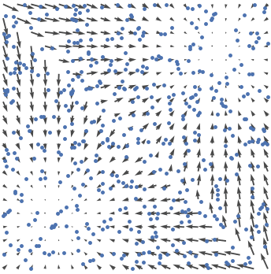
Score-based generative modeling
score
matching
Langevin
dynamics
Data samples
Scores
New samples
Notes:
So far, I have discussed how to estimate scores efficiently from iid samples of a distribution. We can have a score model, and then train it with some efficient variant of score matching to approximate the score of p.
Next, I will show how to build a generative model using the estimated score. This requires us to sample from the score model efficiently.

Slide 33
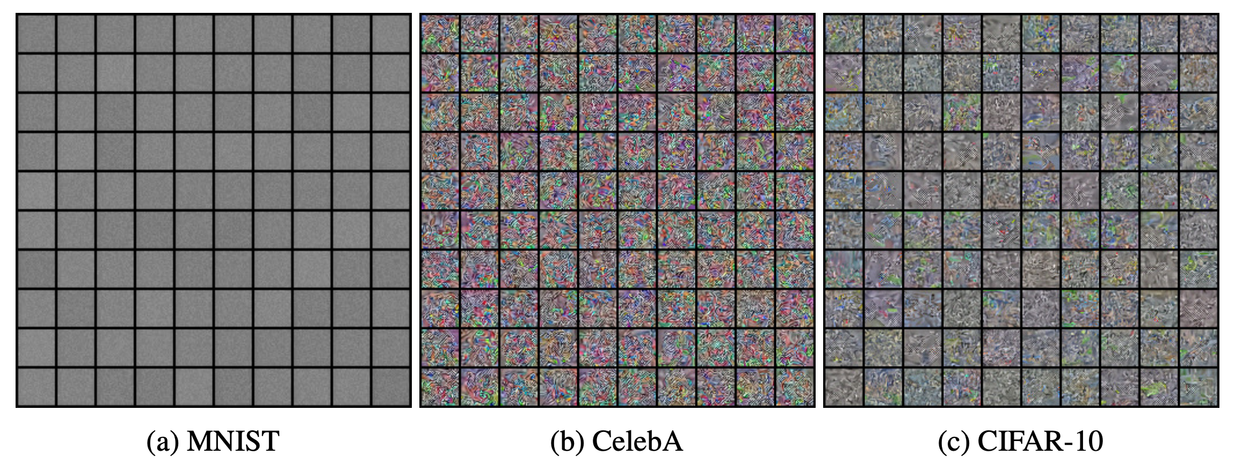
Score-based generative modeling: results
Final samples

Slide 34

Score-based generative modeling: results
Langevin sampling process

Slide 35

Pitfall 1: manifold hypothesis
Manifold hypothesis.
Data score is undefined.
Data points
Notes:
Unfortunately, score-based generative modeling does not work out of the box. We identify several pitfalls that pinpoint the reasons that it does not work well in practice.
The first pitfall is the manifold hypothesis. The manifold hypothesis states that in real world, data points lie in low-dimensional spaces with a much smaller dimension than the data dimension. For example, data points might lie on a two dimensional mobius strip, even though the data dimension is 3.
The score of data distribution is undefined when data are constrained to a low dimensional manifold. Intuitively, suppose the data distribution is concentrated around a ring. When the ring becomes thinner and thinner, the score vectors will also become larger and larger. In the limit that the ring becomes infinitely thin, the score vectors will also become infinitely large. This makes score vectors undefined on a low-dimensional manifold structure.

Slide 36


Pitfall 1: manifold hypothesis
Fitting the data with a low-dimensional linear manifold (PCA)
Score estimation on CIFAR-10.
3072
784
Dim
Dim
595
2165
Notes:
To show the manifold hypothesis is approximately true in practice, we conducted a toy experiment, where we use PCA to find a low-dimensional linear manifold that captures the dataset. Here is our result on MNIST. The first row shows original MNIST images, while the second row shows the result of projecting these images onto the linear manifold.The results show that MNIST images are close to a linear manifold with dimension xx, while the data dimension is. Similarly, most CIFAR-10 images are close to a linear manifold with dimension xx, while the data dimension is xx. Note that a linear manifold with much smaller dimensions is already close enough to all data. The dimension will be even smaller if we fit non-linear manifolds.
The manifold hypothesis indeed has strong negative effects on score estimation. Here is the result of using sliced score matching to estimate scores on the CIFAR-10 dataset. The learning curve first goes down fast and then fluctuates irregiularly and fail to converge.

Slide 37




Challenge in low data density regions
Accurate
Accurate
Inaccurate
Inaccurate
Accurate
Accurate
Langevin MCMC will have trouble exploring low density regions
Song and Ermon. “Generative Modeling by Estimating Gradients of the Data Distribution.” NeurIPS 2019.
Notes:
However, the naïve score matching plus Langevin MCMC does not work well in practice because score estimation is inaccurate in low data density regions.
To illustrate this fact, let’s consider a mixture of Gaussian distribution. The left figure is the data density. The middle figure shows ground-truth data scores, while the right figure shows estimated scores.
Comparing middle and right figures, score estimation is only accurate in the highlighted regions, which are those of high data density. For low-data density regions between the two modes, the score estimation is vastly inaccurate.
Why can this happen? This is because the score matching objective only considers the difference between data and model scores at data samples.
But in regions of low data density where almost no data samples are provided, there is not enough information to infer the correct scores from samples.
This challenge prevents Langevin MCMC from exploring low density regions properly using the learned score model. And it won’t produce good samples when the initialization is bad.

Slide 38





Pitfall 3: slow mixing of Langevin dynamics between data modes
Suppose the data distribution has two modes with disjoint supports:
Data score function:
The score function has no dependence on the mode weighting $π$ at all!
Langevin sampling will not reflect $π$
Notes:
The third pitfall is that Langevin dynamics mix slowly between different modes of the data distribution. Assume the data distribution is composed of two modes with disjoint support. The weight for the first mode is \pi, and the second mode is 1 - \pi. When computing the score in the support of the first mode, we get …. When computing the score in the support of the second mode, we get …. In either case, the score does not depend on the weight of mode \pi. Since Langevin dynamics only use scores, it will never recover the correct weight.
In fact, Langevin dynamics require the density to be differentiable, which is not the case here. But we can imagine that when the two modes are connected but almost disjoint, it will take Langevin dynamics a very long time to recover the weight of modes.

Slide 39

Pitfall 3: slow mixing of Langevin dynamics between data modes

Slide 40

After fixing these pitfalls
Song, Yang, and Stefano Ermon. "Generative Modeling by Estimating Gradients of the Data Distribution.” NeurIPS 2019.

Slide 41

Gaussian perturbation
The solution to all pitfalls: Gaussian perturbation!
Manifold + noise
Score matching on noisy data.
CIFAR-10
Noisy CIFAR-10
Notes:
How can we combat these pitfalls? We propose to perturb the data with Gaussian noise. First, it solves the problem of manifold hypothesis, because Gaussian noise has support all over the space. Recall that when no noise was added, the learning curve of score estimation diverges. When we add a tiny amount of Gaussian noise to the data, the curve converges nicely. Note that the Gaussian noise has a variance of 0.0001, which leaves the perturbed image indistinguishable to humans when the pixel values are in [0,1].

Slide 42
Challenge in low data density regions
Accurate
Accurate
Inaccurate
Inaccurate
Accurate
Accurate
Song and Ermon. “Generative Modeling by Estimating Gradients of the Data Distribution.” NeurIPS 2019.
Notes:
However, the naïve score matching plus Langevin MCMC does not work well in practice because score estimation is inaccurate in low data density regions.
To illustrate this fact, let’s consider a mixture of Gaussian distribution. The left figure is the data density. The middle figure shows ground-truth data scores, while the right figure shows estimated scores.
Comparing middle and right figures, score estimation is only accurate in the highlighted regions, which are those of high data density. For low-data density regions between the two modes, the score estimation is vastly inaccurate.
Why can this happen? This is because the score matching objective only considers the difference between data and model scores at data samples.
But in regions of low data density where almost no data samples are provided, there is not enough information to infer the correct scores from samples.
This challenge prevents Langevin MCMC from exploring low density regions properly using the learned score model. And it won’t produce good samples when the initialization is bad.

Slide 43







Improving score estimation by adding noise
High noise provides useful directional information for Langevin dynamics.
Accurate
Accurate
But perturbed density no longer approximates the true data density.

Slide 44


Multi-scale Noise Perturbation
How much noise to add?
Multi-scale noise perturbations.
…
Notes:
There is a trade-off between data quality and the size of low data-density regions. On the one side of the spectrum, we add very small amount of noise so that the perturbed data are close to the original data, but the low data density regions can be large. On the other side of the spectrum, we add large amount of noise to keep the low data density regions small, but this also destroys the original data.
To mediate the two sides of the spectrum, we propose to perturb data with different levels of noise simulteanously, and aggregate the information from all noise levels.

Slide 45











Trading off Data Quality and Estimation Accuracy
(Red encodes error)
Worse data quality!
Better score estimation!
Notes:
There is a trade-off between data quality and the accuracy of score estimation when considering how much noise we should add.
Let's return to the mixture of Gaussian distribution. When no noise is added, the ground-truth data score is not affected, but the estimated scores are inaccurate in low data density regions. Here red color in the rightmost figure is to code estimation errors.
Now consider perturbing the data with small noise. The red color in the middle figure codes the difference between the perturbed data score and the orignal data score.
When the noise is small, the perturbed distribution is close to the original distribution, but the estimation errors are still high
When we add larger and larger noise, the estimation error becomes smaller and smaller, but the perturbed data score differs from the original data score by a lot.
In order to achieve the best data quality and estimation accuracy at the same time, we should consider all perturbations jointly instead of focusing on only one perturbation.

Slide 46








Annealed Langevin Dynamics: Joint Scores to Samples
Sample using sequentially with Langevin dynamics.
Anneal down the noise level.
Samples used as initialization for the next level.
Notes:
How can we sample from the noise conditional score network using scores of different noise levels?
Our method is called annealed Langevin dynamics. We do langevin dynamics for different levels of perturbed data distribution sequentially. We first use Langevin dynamics to sample from the most perturbed data distribution. Then, the resulting samples will be used as initial samples for sampling from the next noise level. We continue in this fashion, and finally use Langevin dynamics to sample from the least perturbed data distribution.
(fix the animation bug)

Slide 47

Annealed Langevin dynamics

Slide 48



Comparison to the vanilla Langevin dynamics
Langevin dynamics
Annealed Langevin dynamics
Notes:
Annealed Langevin dynamics effectively mitigate the inaccurate estimation of relative weights of different modes. To show this, we conduct Langevin dynamics and annealed Langevin dynamics on the same mixture of Gaussian distribution we used before. Here are the results.
The results from annealed Langevin dynamics is very close to the exact samples, and correctly recovers the relative weights between modes. While Langevin dynamics fail to do so.

Slide 49

Joint Score Estimation via
Noise Conditional Score Networks
Noise Conditional Score Network
(NCSN)
Notes:
More specifically, for each perturbed data distribution, we can easily sample from them, and use score estimation to estimate the corresponding scores.
However, the most naïve way of doing this requires a large number of separate score models to be learned independently, which is very costly.
We propose instead to use a single conditional score network to estimate the scores jointly for all perturbation levels. The score model will take sigma as an input. This model is named the Noise Conditional Score Network.

Slide 50


Training noise conditional score networks
Which score matching loss?
    Sliced score matching?
    Denoising score matching?
Denoising score matching is naturally suitable, since the goal is to estimate the score of perturbed data distributions.
Weighted combination of denoising score matching losses

Slide 51


Choosing noise scales
Key intuition: adjacent noise scales should have sufficient overlap to facilitate transitioning across noise scales in annealed Langevin dynamics.
A geometric progression with sufficient length.
Notes:
Our second technique focuses on determining the rest of noise scales. We claim the noise scales should form a geometric sequence, and should be dense enough to make sure adjacent noise scales are sufficiently close to each other.
For example, the first and second noise should have large overlap.
The second and third noise scales should have the same amount of overlap, and so on

Slide 52





Choosing the weighting function
Weighted combination of denoising score matching losses
How to choose the weighting function:
Goal: balancing different score matching losses in the sum →

Slide 53


Training noise conditional score networks
Sample a mini-batch of datapoints
Sample a mini-batch of noise scale indices
Sample a mini-batch of Gaussian noise
Estimate the weighted mixture of score matching losses
Stochastic gradient descent
As efficient as training one single non-conditional score-based model

Slide 54











Using multiple noise levels
Data
Positive weighting
function
Annealed Langevin dynamics
Noise Conditional
Score Model
Score matching loss

Slide 55
Experiments: Sampling
Notes:
The following demonstrates the sampling procedure of annealed Langevin dynamics using estimated scores on several image datasets. It is pretty amazing that we can start from random noise, modify the images according to scores, and generate nice looking images.

Slide 56







Infinite noise levels

Slide 57








Perturbing data with stochastic processes
Stochastic process
Stochastic differential equation (SDE)
Deterministic drift
Infinitesimal noise
Probability densities
WLOG: Toy SDE

Slide 58



Generation via reverse stochastic processes
Forward SDE (t: 0→T)
Infinitesimal noise in the reverse time direction
Reverse SDE (t: T→0)
Score function!

Slide 59


Score-based generative modeling via SDEs
Time-dependent score-based model
Training:
Reverse-time SDE
Euler-Maruyama (analgous to Euler for ODEs)
Song, Sohl-Dickstein, Kingma, Kumar, Ermon, Poole. “Score-Based Generative Modeling through Stochastic Differential Equations.” ICLR 2021.
Notes:
Therefore, we can generate samples by solving the reverse-time SDE to simulate the reverse-time stochastic process.
One numerical solver for SDEs is the Euler-Maruyama method. It is based on the same idea as Euler’s method for solving ODEs. Basically, we replace the infinitesimal time step dt with a small time difference Delta t, and we replace the infinitesimal white noise with a Gaussian noise with variance Delta t. Here Delta t is a negative time step, and t goes from T to 0.
We can train a time-dependent score-based model to approximate the score function as a function of time. This time-dependent score-based model is a neural network conditioned on time t, and can be trained by first randomly sampling t, and then minimizing the corresponding score matching loss.

Slide 60
Predictor-Corrector sampling methods
Predictor-Corrector sampling.
    Predictor: Numerical SDE solver
    Corrector: Score-based MCMC
corrector
predictor
Notes:
We can apply any other general-purpose SDE solver for sampling. Besides, knowing the score function allows new SDE solvers and hence new samplers. The first method we consider is one family of methods named predictor-corrector samplers. As the name suggests, the method consists of a predictor and a corrector. The predictor can be a general-purpose SDE solver like the Euler-Maruyama method, and the corrector can be any score-based MCMC approach such as Langevin dynamics.
So how does the method work? When solving the reverse-time SDE, we first use the predictor to get a rough estimate of the intermediate sample at the next time step, and then use the corrector to fine-tune the sample. This procedure is repeated multiple times until we finally get a sample from the original unperturbed data distribution.
Predictor-Corrector methods assembles annealed Langevin dynamics. However, the introduction of the predictor helps Langevin dynamics to make a smooth transition between different noise scales.

